Slide 1
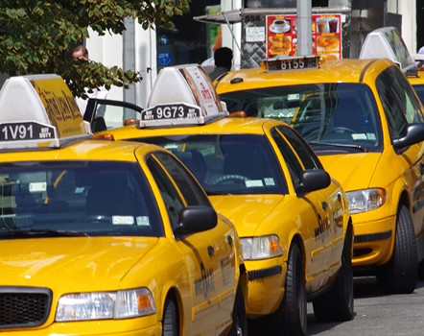
Taxi mobility challenge
Martha-Evgenia Nikolaou
10/09/2021

Slide 2
Summary
This work estimates the pollution reduction when the taxicab fleet changes from combustion engine-powered vehicles to electric vehicles and by predicts when the next taxi pick up will happen.
By changing 15% of the fleet each month, there will be 619196678.45 grams.
The developed approach predicts when the next pick up will take place with an accuracy of 1,31 miles.
The approach seems promising but further developments can lead to more accurate predictions.

Slide 3
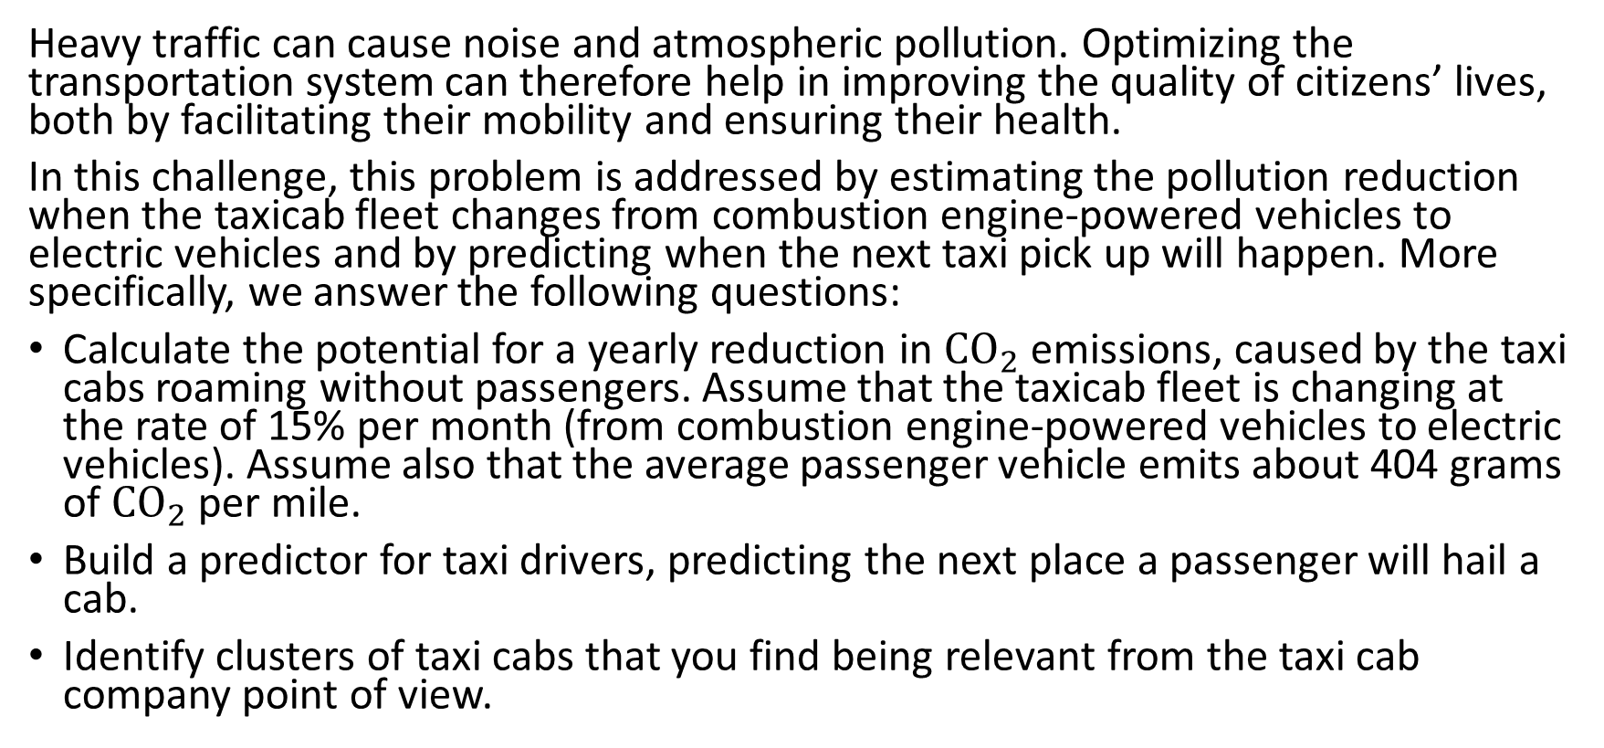
Problem description
Heavy traffic can cause noise and atmospheric pollution. Optimizing the transportation system can therefore help in improving the quality of citizens’ lives, both by facilitating their mobility and ensuring their health.
In this challenge, this problem is addressed by estimating the pollution reduction when the taxicab fleet changes from combustion engine-powered vehicles to electric vehicles and by predicting when the next taxi pick up will happen. More specifically, we answer the following questions:
Calculate the potential for a yearly reduction in ${CO}_{2}$ emissions, caused by the taxi cabs roaming without passengers. Assume that the taxicab fleet is changing at the rate of 15% per month (from combustion engine-powered vehicles to electric vehicles). Assume also that the average passenger vehicle emits about 404 grams of ${CO}_{2}$ per mile.
Build a predictor for taxi drivers, predicting the next place a passenger will hail a cab.
Identify clusters of taxi cabs that you find being relevant from the taxi cab company point of view.

Slide 4
Data description
Mobility traces of 537 taxi cabs in San Francisco
~30 days
Variables:
Latitude
Longitude
Occupancy
Time

Slide 5
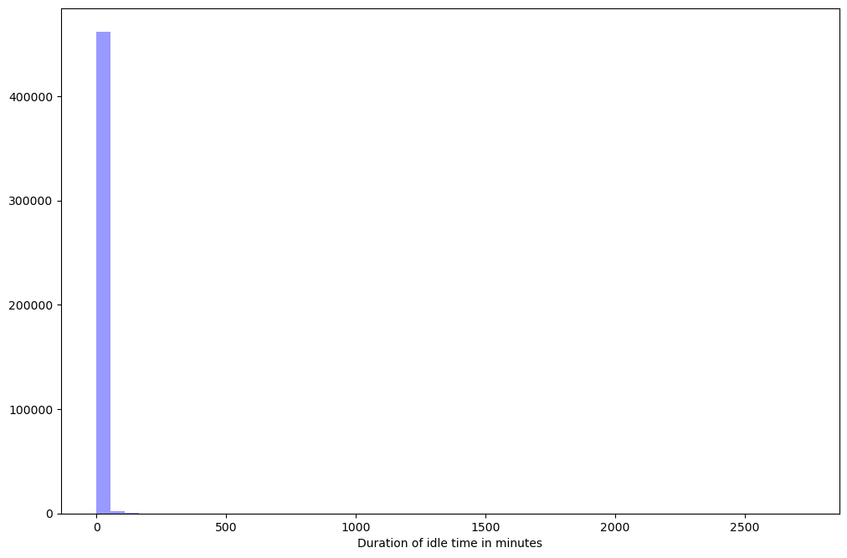
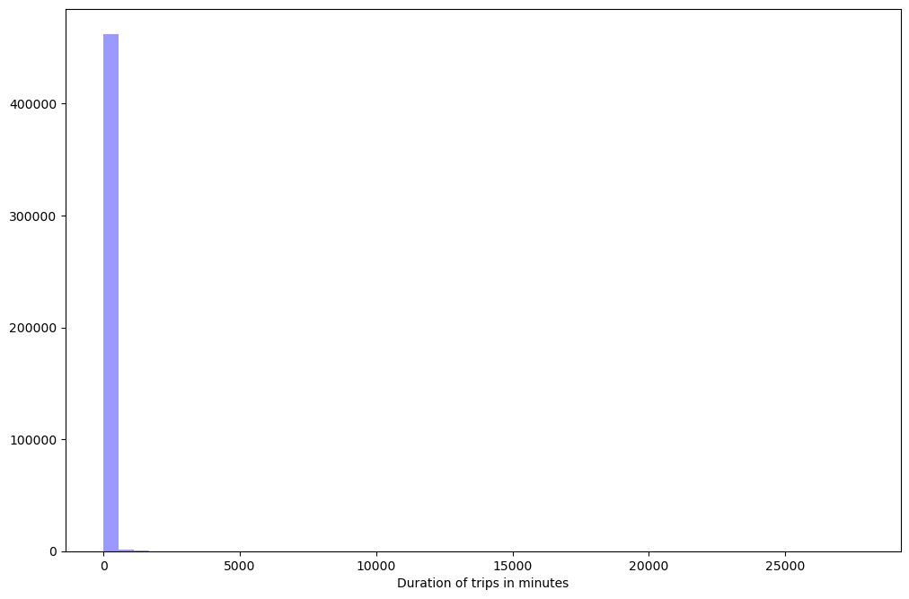
Data validity
No missing values
No profound outliers (coordinates or time)
Not stable data frequency (sometimes missing days)
Some weird occurrences in duration of trips and idle time

Slide 6
Assumptions
If data missing > 15 minutes, it is considered as a different trajectory
Keep only data where trip < 180 minutes
Keep only data where idle time < 50 minutes
Under these assumptions, there are 231479 identified rides

Slide 7
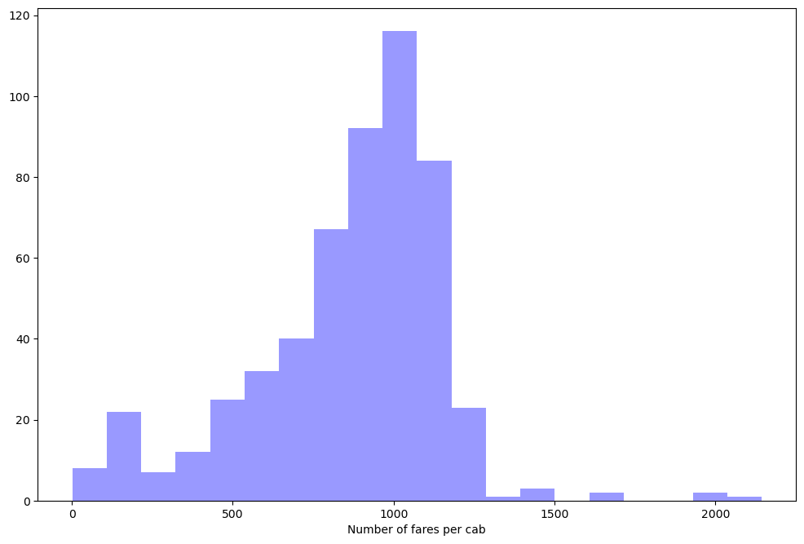
Exploratory data analysis – Fares per cab
Most of the cabs have ~1000 fares within a month. There are just a few cabs that have more than 1200 fares in a month.

Slide 8
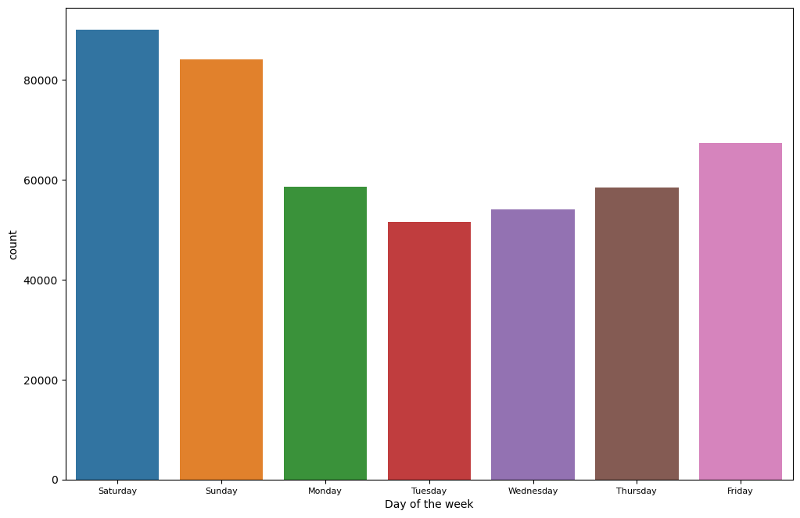
Exploratory data analysis – Fares per day of the week
Most of the fares occur during the weekend. Nothing surprising here since it is connected to the people having free time and going out for entertainment.

Slide 9
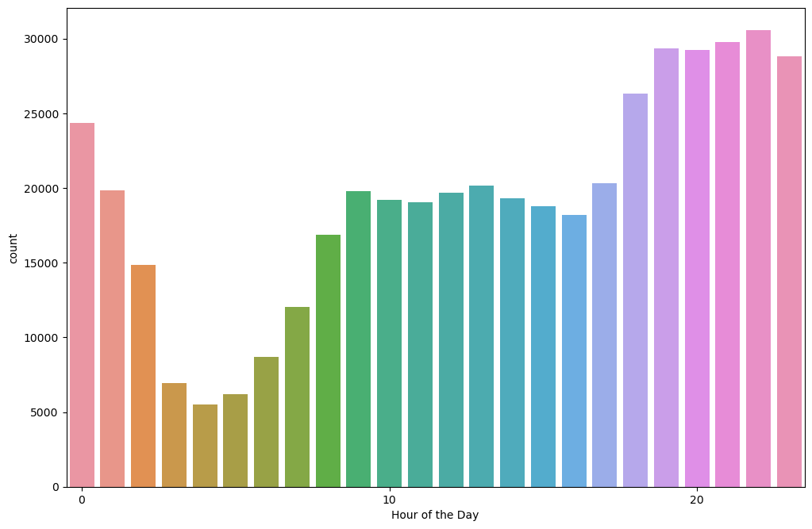
Exploratory data analysis – Fares per hour of the day
Most of the fares occur during the nighttime hours. Nothing surprising here since it is connected to the people going out for entertainment.

Slide 10
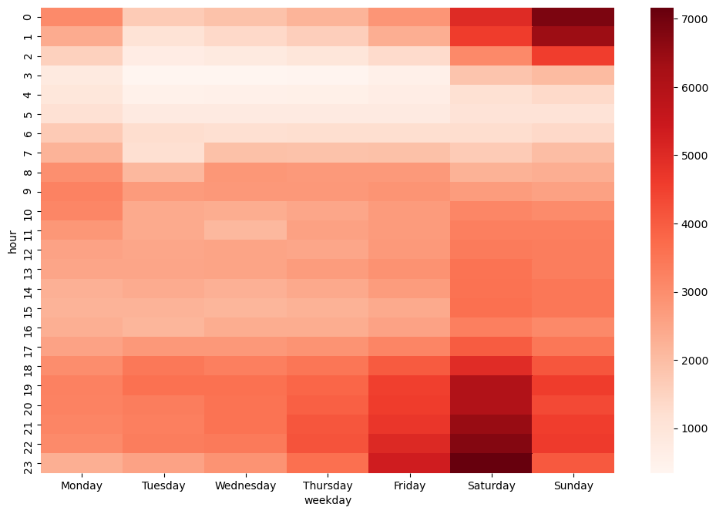
Exploratory data analysis – Fares per day and time
Most of the fares occur during the Friday and Saturday nighttime hours. Very few fares occur in the early hours, while we see some occurrence during the work commuting hours.

Slide 11

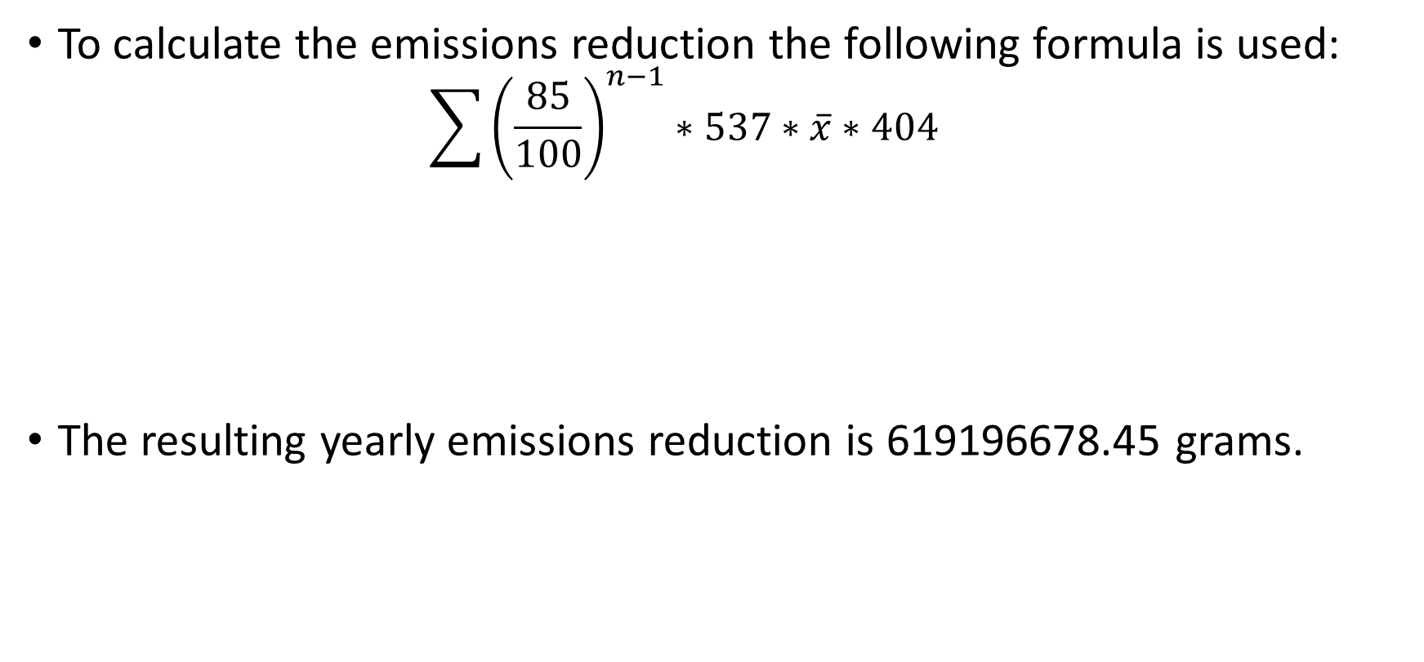
CO2 emissions reduction
To calculate the emissions reduction the following formula is used:
$$\sum{{\left(\frac{85}{100}\right)}^{n−1}∗537∗\overline{x}∗404 }$$
The resulting yearly emissions reduction is 619196678.45 grams.
15% monthly reduction
537 cabs
Average no occupancy distance
$CO_{2}$ grams emmisions per mile

Slide 12
Prediction of next pick up
Variables:
Hour of the day
Coordinates of previous two trips
Results
Mean Square Error on training Data:0.00013
Mean Square Error on testting Data:0.00076
Distance error in miles (average): 1,31 miles

Slide 13
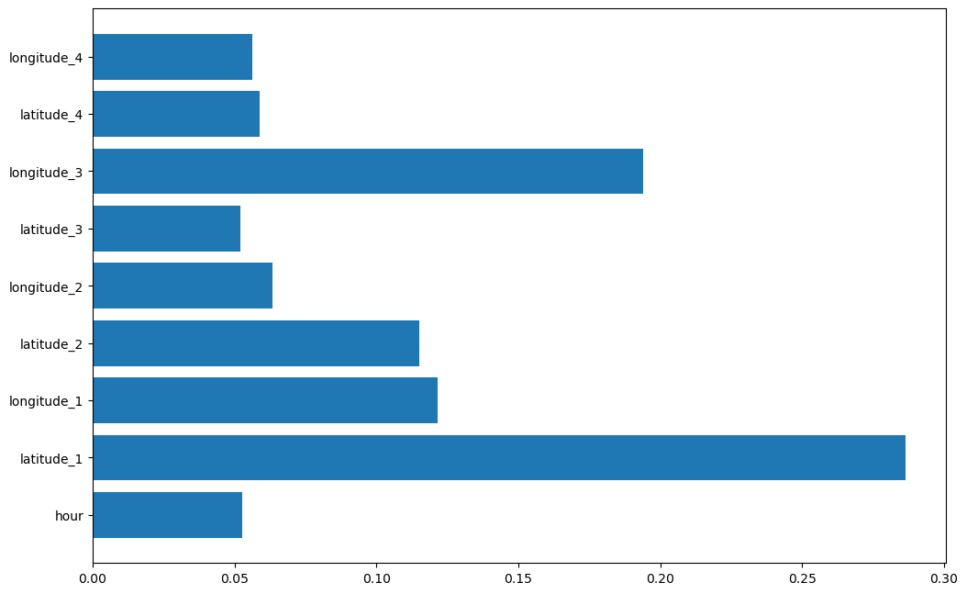
Prediction variable importance
The most important features are the coordinates of the previous trip, followed by the coordinates of the trip before. Hour of the day seem to be important as well.

Slide 14
Recommendations
The created features are important in the model
Incorporating additional external data
E.g. Foursquare POI
Use a different model that accounts for sequential data (e.g. LSTM)

Slide 15
Clustering of taxi cabs (Ideas)
Clusters per routes (to identify preference and probably weird routes)
Clusters per routes and time/day (to identify preference and probably weird routes)
Discover if specific taxi cabs show weird behavior (wondering around with/without passengers for a long time, on specific time/day)
Intersection of routes to increase/reduce taxi cab presence in specific locations

